Slide 1
CSCIU 210 Computer Organization AKM Jahangir A Majumder, PhD
Fall 2018 - Lecture 26
October 31, 2018
Note: Some slides are adapted from those used by previous instructors and some slides include figures from the textbook.

Slide 2
Review and Learning Outcomes
We will CONTINUE our coverage on MIPS assembly language
We will learn followings today:
Memory vs. Register
MIPS Register Conventions
MIPS Control Instruction
Inequalities in MIPS
We will learn how to write code in MIPS simulator
We will have Quiz 5 on Friday, November 2, which will cover lecture 20-24
HW 5 is due today

Slide 3
Summary
So far, we covered the following MIPS Instructions and Registers:
Instructions:
add, sub, addi, lw, sw
Registers:
C Variables: $s0 - $s7
Temporary Variables: $t0 - $t7
Zero: $zero
Reading Materials: Textbook chapter 2.1-2.3.

Slide 4
The First Program: Hello World
.text
.globl main
main:
li $v0, 4
la $a0, str
syscall # print string
li $v0, 10
syscall # exit (you must use syscall #10 to exit)
.data
str: .asciiz "Hello World!!!"

Slide 5
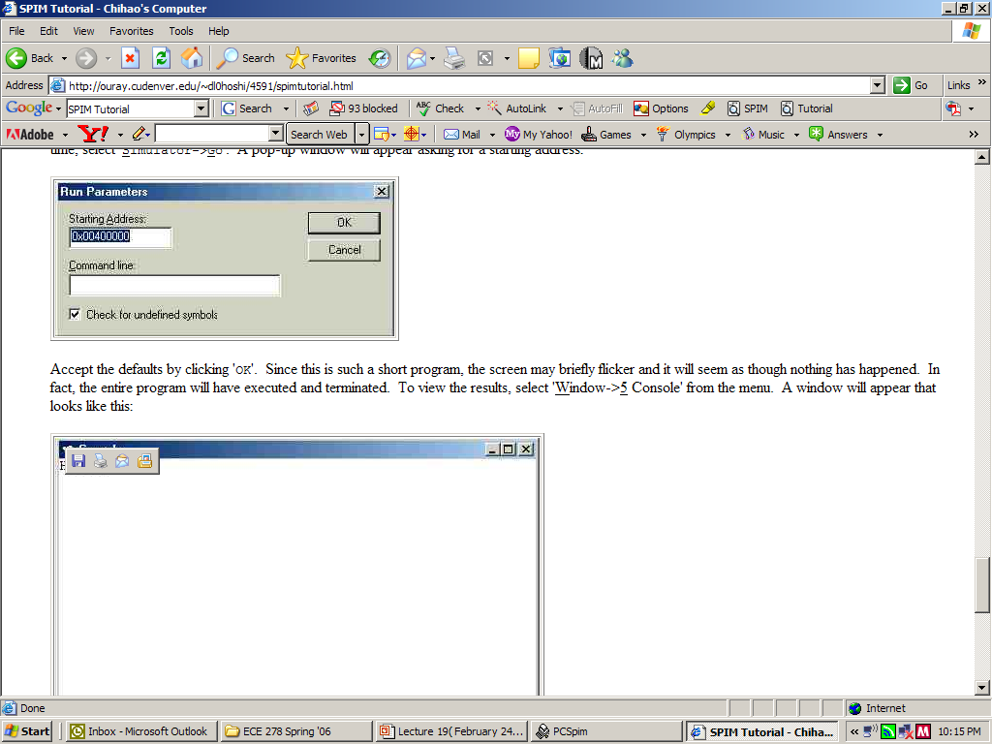
Execute the program
Starting address is 0x00400000

Slide 6
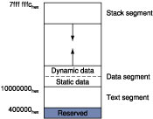
Layout of MIPS Computer Memory

Slide 7
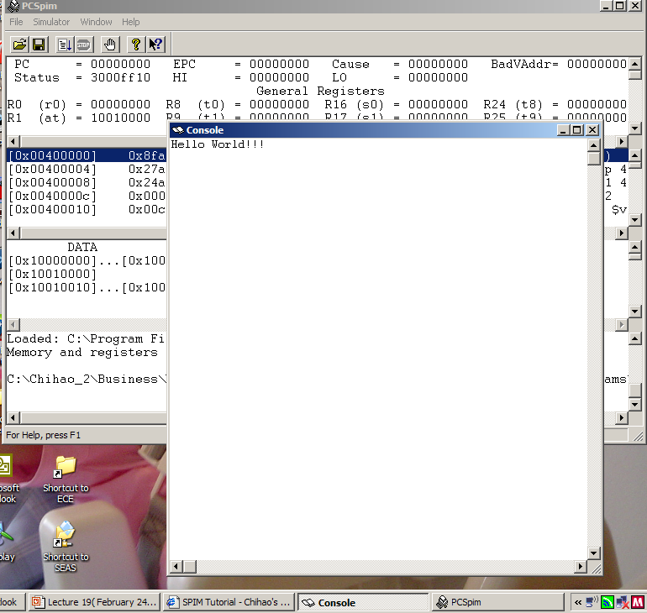
Result of Example Program 1

Slide 8
The Second Program: Addition
.data # data
val1: .asciiz "Enter 1st integer: "
val2: .asciiz "Enter 2nd integer: "
str: .asciiz "The result = “
.text # INSTRUCTIONS
.globl main
main: li $2, 4 # print string
la $4, val1
syscall
li $2, 5 # read 1st in -- result in r2
syscall
move $16, $2 # save 1st integer
li $2, 4 # print string
la $4, val2
syscall
li $2, 5 # read 2nd int -- result in r2
syscall
add $16, $16, $2 # sum both integers
li $2, 4 # print string
la $4, str
syscall
li $2, 1 # print int
move $4, $16
syscall
li $2, 10 # exit program
syscall

Slide 9
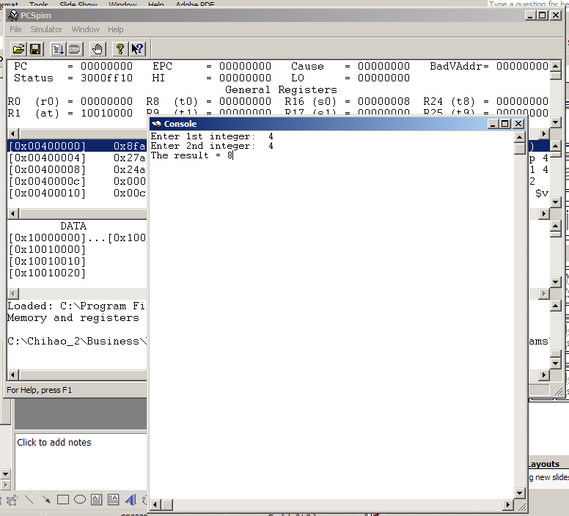
Result of Example Program 2

Slide 10
The Third Program: Taking Text Input
.data # data
prompt: .asciiz "Please enter your name (last, first): "
yname: .asciiz "xxxxxxxxxxxxxxxxxxxxxxxxxxx”
.text # INSTRUCTIONS
.globl main
main: li $2, 4 # print prompt
la $4, prompt
syscall
li $2, 8 # read string
li $5, 20 # length of string = 20
la $4, yname
syscall
li $2, 4 # print result
la $4, yname
syscall
li $2, 10 # exit program
syscall

Slide 11
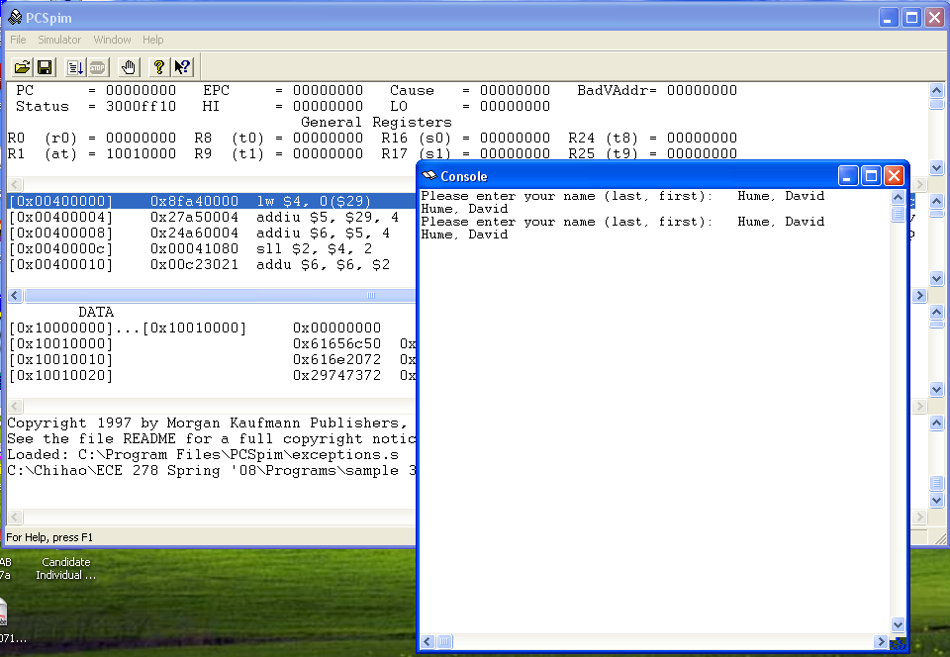
Result of Example Program 3

Slide 12
Exercise
Write a program implementing the following functions.
Ask the user to enter a number with the following prompt
"Please input an integer:”
Add the number by one
Print out the result after the following message
"Next integer is: "

Slide 13
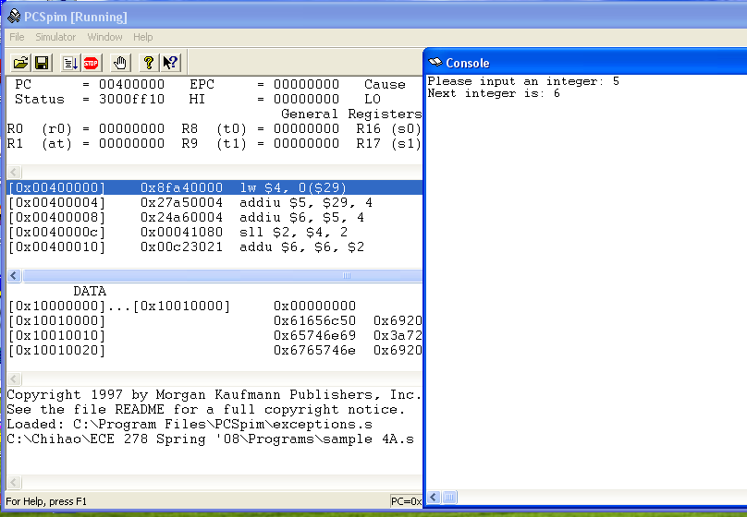
Result of Program Exercise

